Slide 1
Topic 4: Part II
Analysis of algorithms
【See Chap17.3 in the textbook】

Slide 2
Analysis of algorithms
Evaluating the relative efficiency of algorithms will be a major topic that is usually called analysis of algorithms.

Slide 3
Evaluating algorithmic efficiency
Facts:
1.An algorithm that runs more quickly with one set of input values may turn out to run more slowly for others.
2.Some algorithms work well for a small amount of input data but deteriorate in performance when the amount of data becomes large.

Slide 4
Computational Complexity
When evaluating algorithmic efficiency, using the letter N to represent the size of the problem.
The central question in analysis of algorithms is to determine how the running time changes as a function of N.
The relationship between N and the running time of an algorithm as N becomes large is called the computational complexity of that algorithm.

Slide 5

Selecting sort revisited
In Chapter 12, the algorithm used to implement SortIntegerArray is called selection sort.
The algorithm takes N steps to fill the first position, N-1 steps to fill the second, and so on, the total running time is proportional to N + N-1 + N-2 +… + 3 + 2 +1
As explained in the section on Analyzing the selection sort algorithm in Chapter 12, this formula can be simplified to

Slide 6



Big-O Notation of Selecting sort
1. Eliminate any term in the formula that
becomes insignificant as N becomes large
2. Eliminate any constant coefficients.
3. The expression used to indicate the
complexity of selection sort is

Slide 7
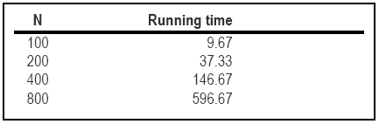
Quadratic Time
Algorithms that exhibit O(N²) performance are said to run in quadratic time.
The basic characteristic of quadratic complexity is that, as the size of the problem doubles, the running time increases by a factor of four. Table12-1.

Slide 8
Divide-and-conquer strategies
Doubling the size of a quadratic problem has the effect of multiplying its running time by four.
Dividing the size of a quadratic problem by two, you decrease the running time by that same factor of four.
If you divide a large array in half and use the selection sort algorithm to sort each half, you end up with two sorted subarrays in half the time it would have taken to sort the entire array.

Slide 9

Divide-and-conquer algorithms
Recursive algorithms that divide a problem into roughly equal subproblems and then solve each subproblem recursively are called divide-and-conquer algorithms.
To make this question more concrete, let’s go back and think about the array of eight elements used as an example in Chapter 12.

Slide 10
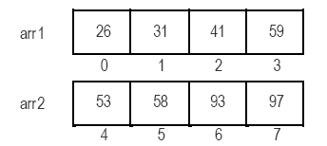
Example:
Dividing the array of eight elements into two array of length four and then sort each of those smaller arrays as follows.
Then merging the two smaller arrays into the original array to complete the sorting.

Slide 11
Merging two arrays
As it happens, reconstruction the complete array from the smaller sorted arrays is a much simpler problem than sorting itself.
The first element in the complete ordering must be either the first element in arr1 or the first element in arr2, whichever is smaller.

Slide 12
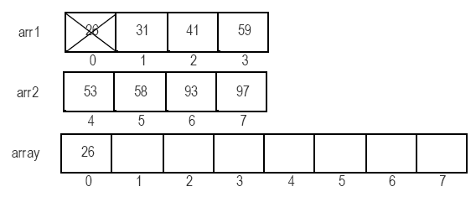
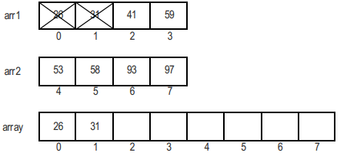
Merging of arr1 and arr2

Slide 13
The merge sort algorithm
The merge operation, combined with recursive decomposition, gives rise to a new sorting algorithm called merge sort.
Merge Sort Executing the following steps:
(1) Divide the array into two smaller arrays, each
of which is half the size of the original.
(2) Sort each of the smaller arrays by making a
recursive call to SortIntegerArray.
(3) Merge the two small arrays back to fill the
original one.

Slide 14
The code for the SortIntegerArray
void SortIntegerArray (int array[], int n)
{
int i, n1, n2, *arr1, *arr2;
if (n > 1) {
n1 = n / 2;
n2 = n – n1;
arr1 = NewArray (n1, int);
arr2 = NewArray (n2, int);
for (i = 0; i < n1; i++) arr1[i] = array[i];
for (i = 0; i < n2; i++) arr2[i] = array[n1 + i];
SortIntegerArray (arr1, n1);
SortIntegerArray (arr2, n2);
Merge (array, arr1, n1, arr2, n2);
FreeBlock (arr1);
FreeBlock (arr2);
}
}

Slide 15
The code for Merge Function
void Merge (int array[], int arr1[], int n1, int arr2[], int n2)
{
int p, p1, p2;
p = p1 = p2 = 0;
while (p1 < n1 && p2 < n2) {
if (arr1[p1] < arr2[p2])
array[p++] = arr1[p1++];
else
array[p++] = arr2[p2++];
}
while (p1 < n1) array[p++] = arr1[p1++];
while (p2 < n2) array[p++] = arr2[p2++];
}

Slide 16
Computational complexity of merge sort
You now have an implementation of the
SortIntegerArray function that implements
the strategy of divide-and-conquer.
2. How efficient is it?

Slide 17
Complexity Analysis of Merge Sort
Calling the merge sort implementation of SortIntegerArray on a list of N numbers, the running time can be divided into two components:
The amount of time required to execute the
operations at the current level of the
recursive decomposition
2. The time required to execute the recursive
calls

Slide 18
Running Time
The total time required to solve the problem is the sum of the time required at each level of the recursive decomposition.
As you move down through the recursive hierarchy, the arrays get smaller, but there are more of them.
Determining the total amount of work is therefore a question of finding out how many levels there will be.

Slide 19
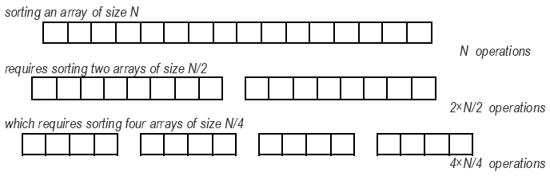
Running Time (Continue)
The total number of levels is equal to the number of times you can divide N by 2 before you get and down to 1.

Slide 20
Running Time (Continue)
Need to find a value of k such that N=2^{k}
Solving the equation for k gives k= log₂N
Because the number of levels is log₂N , The amount of work done at each level is proportional to N, the total amount work is proportional to N log₂N.
Thus, the computational complexity of merge sort is usually written as O(N log N)

Slide 21
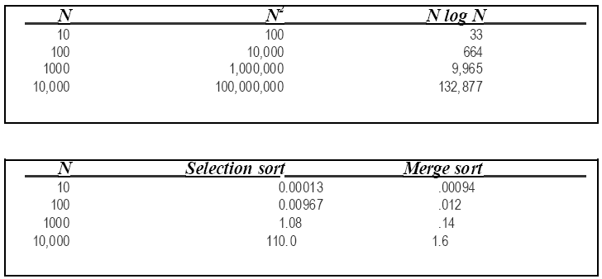
Comparing quadratic and N log N performance

Slide 22
SUMMARY
The computational complexity of algorithms is usually expressed using big-O notation, which indicates how the running time of a program is affected by changes in problem size.
Reducing the computational complexity of an algorithm can have a profound effect on its efficiency.

Slide 23
Projects（选做1题）
1、快速排序算法实现及效率分析。
Another good example of recursion is quicksort, a sorting algorithm developed by C.A.R. Hoare in 1962. Given an array, one element is chosen and the others partitioned in two subsets - those less than the partition element and those greater than or equal to it. The same process is then applied recursively to the two subsets. When a subset has fewer than two elements, it doesn't need any sorting; this stops the recursion.
要求：从一个数据文件中读入N个整数（N<=100000），且把结果保存到另一个文本文件中，并显示排序所用的时间。

Slide 24
Projects（选做1题）
2 、融合选择法和归并法的排序算法实现及效率分析。
As shown in Table 17-2, selection sort is faster for small arrays than merge sort, although the situation is reversed when the arrays get larger. If you want to design a SortIntegerArray implementation that works well over a wide range of sizes, you can combine the two strategies by using merge sort on large arrays and selection sort on small arrays. Reimplement SortIntegerArray using this strategy. How might you go about choosing the cutoff point separating large arrays from small ones?
要求：从一个数据文件中读入N个整数（N<=100000），且把结果保存到另一个文本文件中，并显示排序所用的时间。

